Slide 1
🤖🏁 Turing Test
AI Reporting Feature for Compliance
Erin Pangilinan I Dave Howard I Brandon Rutter-Daywater
Notes:
Erin

Slide 2
Enterprise customer compliance experts need better visualization of vulnerabilities for SME and large companies with code base.
Increasing Complexity: AI-generated code is becoming more complex, making it difficult to identify vulnerabilities.
Compliance Challenges: Ensuring compliance with cybersecurity standards is time-consuming and error-prone.
Lack of Visualization Tools: Current tools do not provide intuitive visualizations for AI-generated code risks, and checks for this type of compliance are not integrated in the development cycle.
PROBLEM

Slide 3
Increasing Complexity: AI-generated code is becoming more complex, making it difficult to identify vulnerabilities.
Compliance Challenges: Ensuring compliance with cybersecurity standards is time-consuming and error-prone.
Some organizations have policies that restrict the use of AI tools to help with code generation.
Lack of Visualization Tools: Current tools do not provide intuitive visualizations for AI-generated code risks, and checks for this type of compliance are not integrated in the development cycle.
PROBLEM

Slide 4
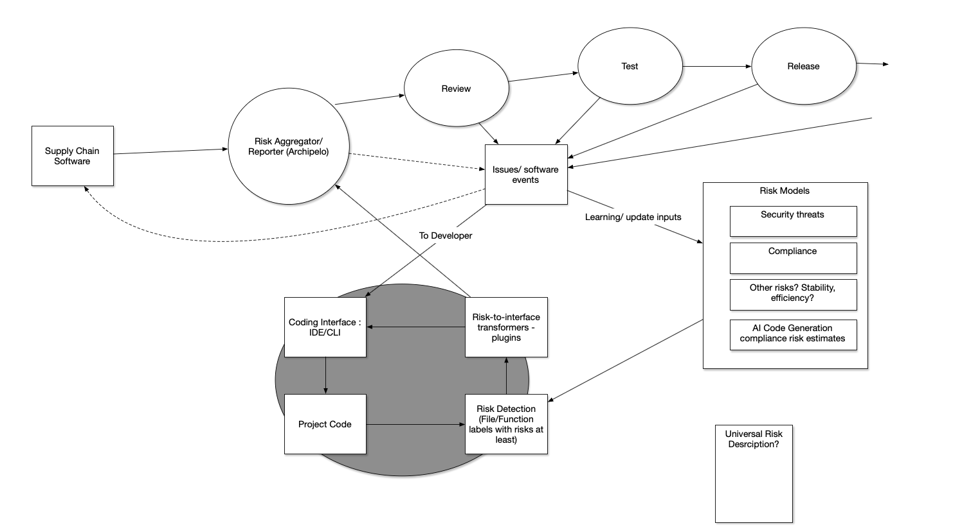
Framing Our Solution
Notes:
Brandon

Slide 5
Framing Our Solution

Slide 6
A Python based script/integration using AI foundation model to return confidence level reflecting how much of a code base was written by an AI.
We report scores both to coding interface for devs, and to Archipelo/CI for transparency and collaboration across dev, security, and compliance teams
Benefits: Turing Flag improves efficiency and accuracy for cybersecurity compliance experts, while allowing developers to review and address issues pre-commit.
SOLUTION OVERVIEW

Slide 7
FEATURES
Solution #1
Compliance Dash Feature - The chart that goes into Archipelo Dashboard
The Dashboard displays a quick overview within a code repository project, including for each file the % confidence it was written by AI.
Integrated with other Archipelo risk reports.
Solution #2
VS Code Command Line Data Visualization Dashboard - Identify Percentage of AI for each file, or for file currently being edited.

Slide 8
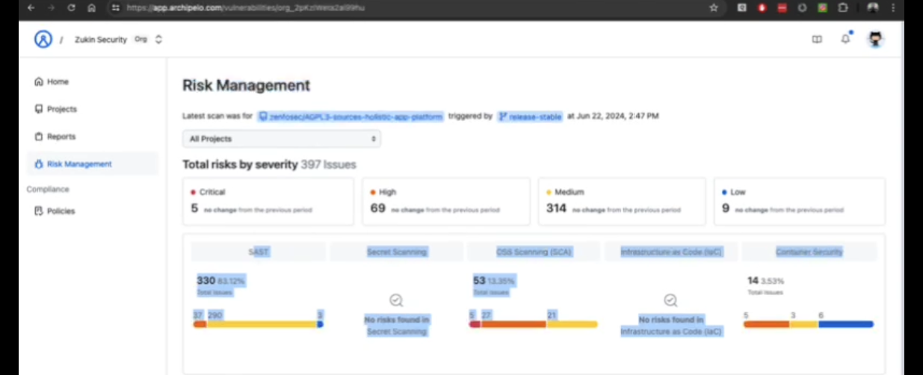
Solution #1: Compliance DSash Feature
Notes:
Erin

Slide 9
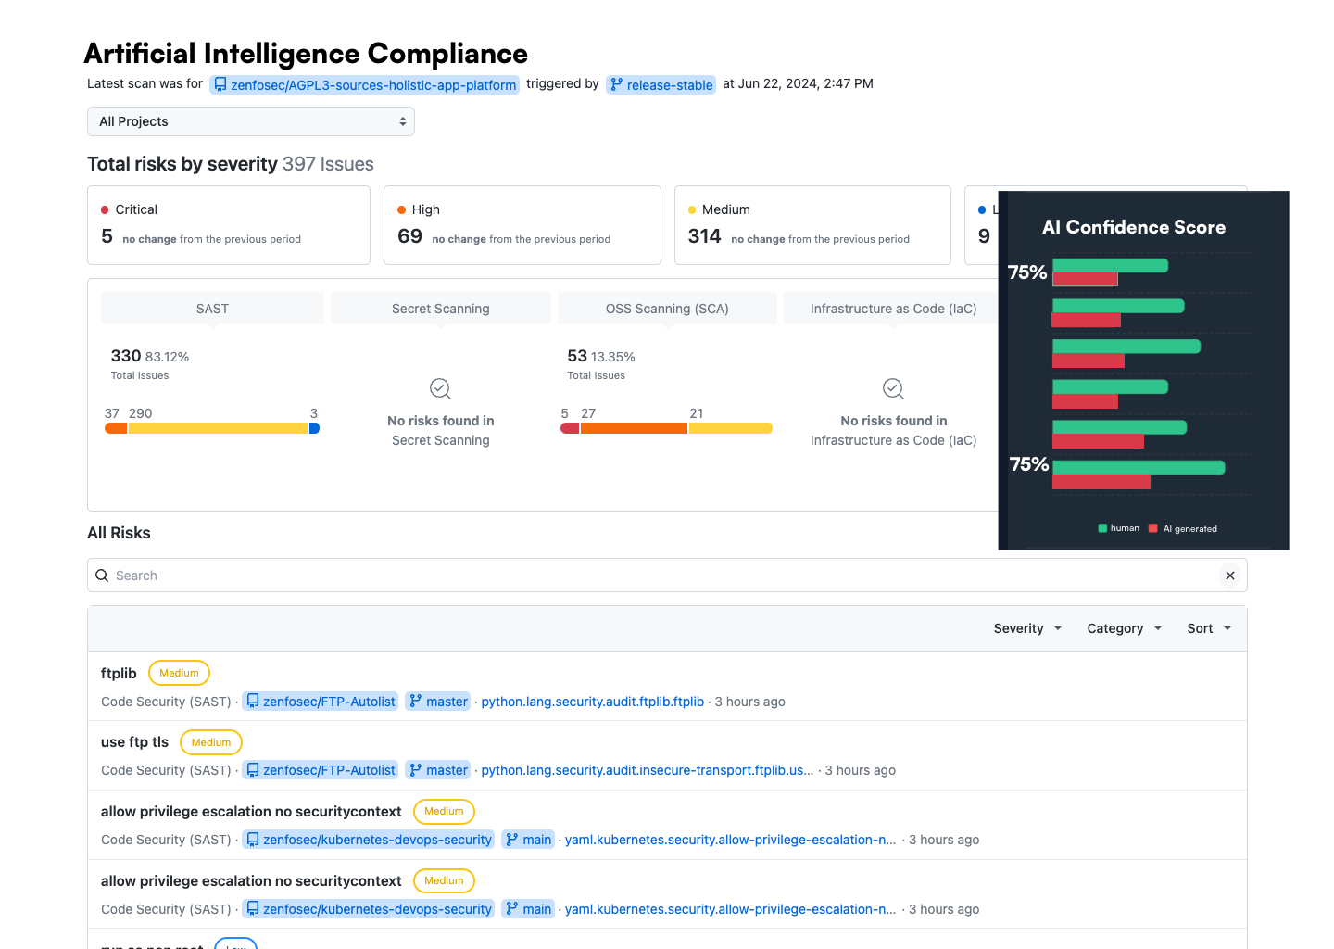
// Added Dashboard Component Visualizing AI Identifier

Slide 10
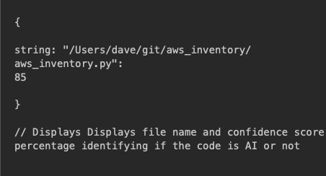
JSON
Notes:
Erin

Slide 11
CLI-based AI Flag
This Python code shows a quick dashboard overview within a code repository project the % and score of _____.
Notes:
Dave

Slide 12
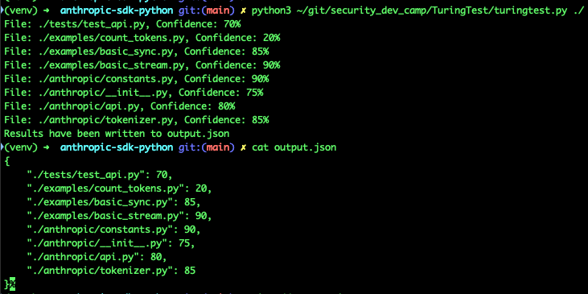
CLI Screenshot
Each file and risk score, confidence level
Watch output
List of files the repo
Each one has confidence score
This Dashboard displays shows a quick dashboard overview within a code repository project the % and score of.
AI-Powered Analysis:
Use AI tools to analyze code and detect AI-generated code.

Slide 13
If we had more time, we would develop out an integration more fully with other foundation models and a real VS Code extension plugin.
Extension of this integration approach to other risk types.
Code splitting could be used for AI/ML detection of other risk types.
FUTURE WORK

